Slide 1
Introduction to CMOS Mixed Signal IC Design
Mixed Signal Circuit--both analog and digital circuits are integrated on the same substrate.
This class will focus on analog circuit design and the interface circuit design between analog and digital.
Course Prerequisites
  Basic understanding of electronics
    active and passive components
  Basic CMOS integrated circuit technology
    CMOS transistor properties
    Modeling and characteristics
    Fabrication procedure

Slide 2
CMOS Analog Integrated Circuits
Integrated Circuit—active and passive components are on a single substrate. Geometry and performance are under the control of the designers. Use spice like simulations to analyze circuit performance and adjust designs to meet specifications.
CMOS-- Complementary Metal-Oxide-Semiconductor technology

Slide 3
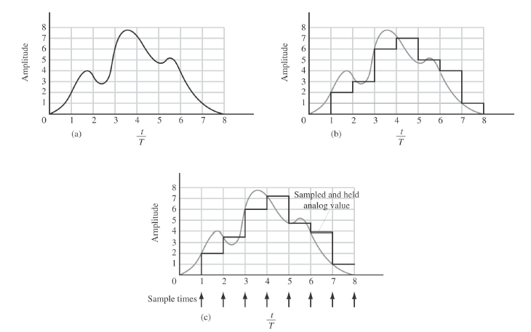
Signal Circuits Covered in This Class
Analog Circuits
  Analog switch
  Sample/hold
  Inverter amplifier
  Differential Amp
  Operational Amp
  Analog buffer
  Comparators
  Mixed Signal Circuits
  Analog/digital converters
  Digital/analog converters
Analog signal
Digital signal
Analog sampled-data signal

Slide 4
Labs
Labs are an important part of this course. Will use Cadence CAD tools, Virtuoso Schematic Analog Design Environment (ADE).
Emphasis will be circuit design/debugging, so will use Cadence Tools to
  Capture transistor level schematic
  Extract netlist for simulation
  Perform simulation
    DC analysis—plot node response (voltage/current) while sweeping DC voltage or other parameters
    Transient analysis—plot node response as a function of time
    AC analysis (Bode plot)—plot node response as a function of frequency (use linear model). Must be careful that transistors have proper bias conditions to keep linearized model correct.

Slide 5
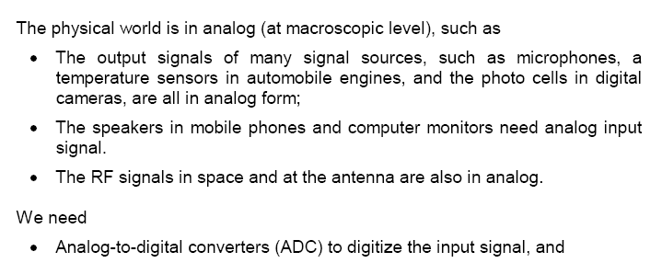
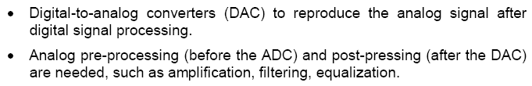
Why is Analog Signal Processing Required

Slide 6
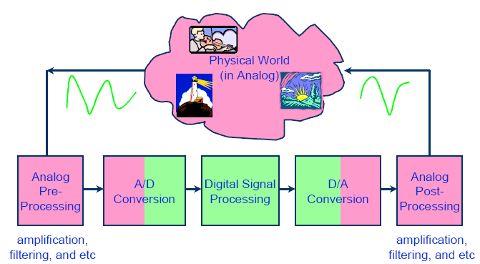
ADCs, DACs, and pre-/post- processing analog circuits are required to interface the DSP core and the physical world

Slide 7
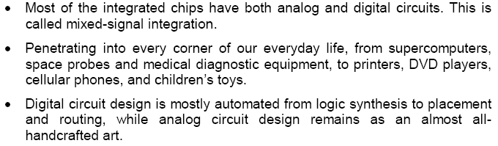
Integrated circuits of today

Slide 8
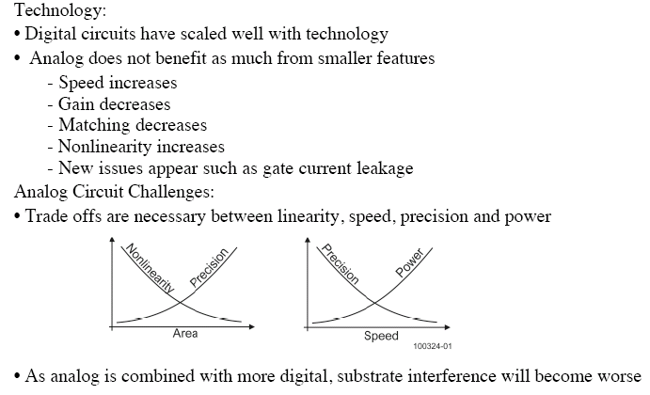
Analog IC Challenges

Slide 9
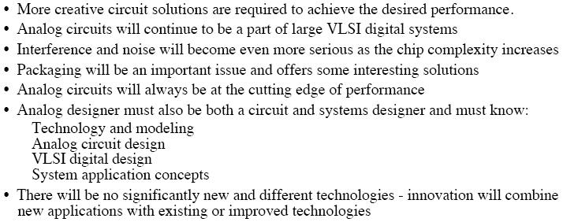
What is the Future of Analog IC Design

Slide 10
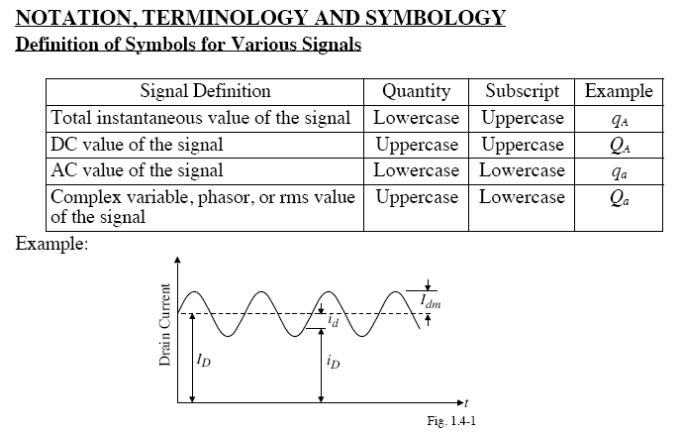

Slide 11
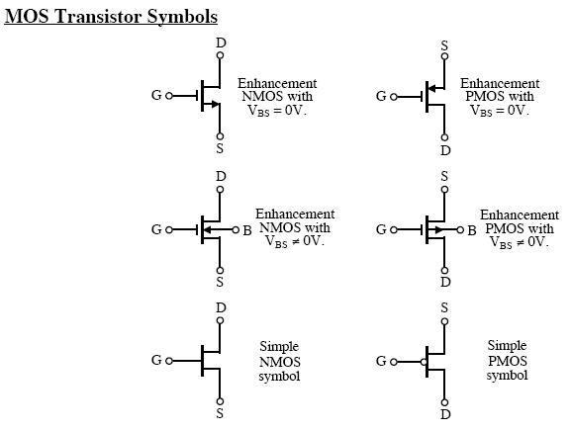
20260825
These are “Depletion” FETs.
We will restrict our studies to the “Enhancement” MOSFETs in the upper panel.

Slide 12
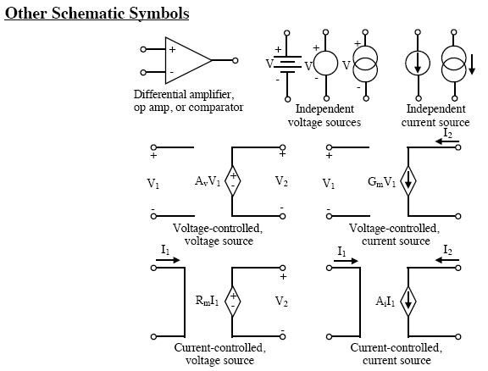

Slide 13
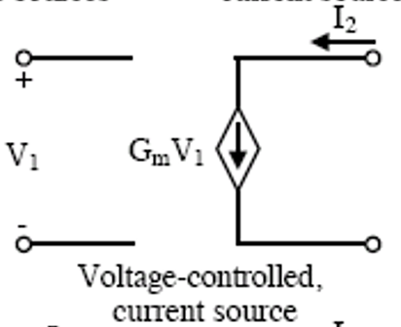
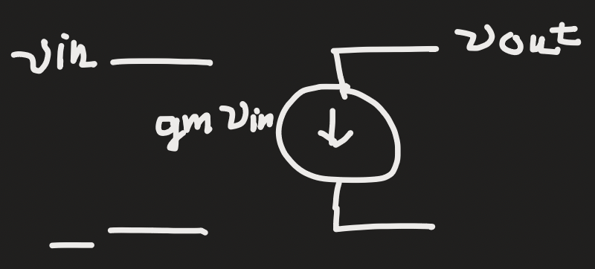
Note about Current Source symbols
You may develop your own style as you progress.

Slide 14
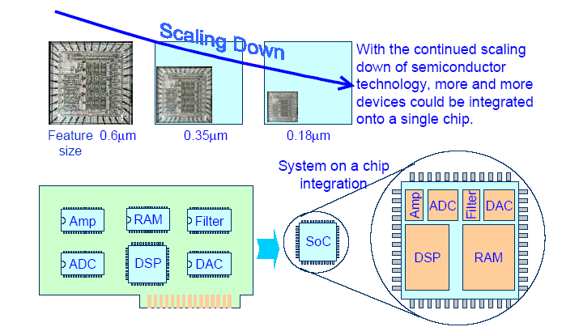
Mixed-signal system-on-a-chip integration

Slide 15
Why CMOS Mixed-Signal Integration
CMOS technologies have the following advantages:
Very large scale integration of both high density analog and digital circuits for low cost and low power.
Ideal properties of MOS switches for high accuracy sample-data circuit, such as switch capacitor filters, A/D and D/A converters.
New feature technologies with small feature sizes (such as 180nm and 90nm, 45nm, 32nm, 10nm) can operate at increasingly high speed (>10 GHz), comparable to some bipolar technologies.
Bipolar silicon technologies
Bipolar technologies can operate at higher frequencies than CMOS with relatively larger power consumption.
Suitable for pure analog integration with relatively high operating speed (such as RF circuit) or relatively high power (such as Asymmetric Digital Subscriber Line--ADSL line driver) applications.
Digital circuits in bipolar are power hungry, prohibiting very large scale integration.
Notes:
Asymmetric Digital Subscriber Line (ADSL) is one form of the Digital Subscriber Line technology, a data communications technology that enables faster data
ADSL (Asymmetric Digital Subscriber Line, or DSL for short) is a high-speed Internet access service that utilizes existing copper telephones lines to send and receive data at speeds that far exceed conventional dial-up modems.

Slide 16
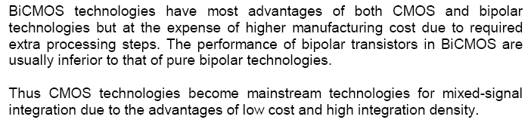
Why CMOS Mixed-Signal Integration (cont.)

Slide 17
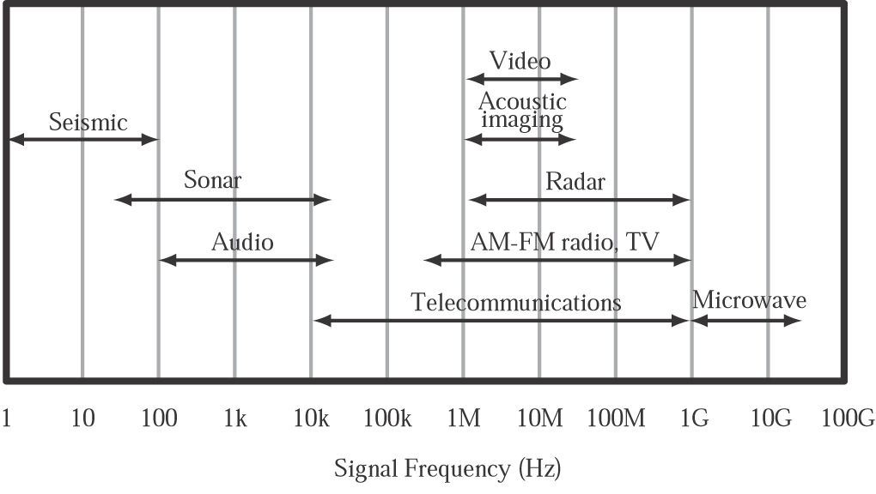
Frequency of signals used in signal processing applications

Slide 18
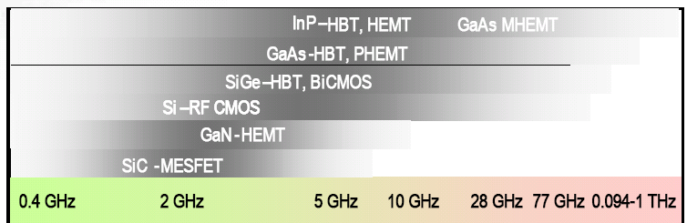
Frequency that can be processed by different technologies
Source from ITRS 2010
Notes:
Standard Industrial Classification –SIC
MESFET stands for metal semiconductor field effect transistor
heterojunction bipolar transistor (HBT)
SiC-Silicon Carbide

Slide 19
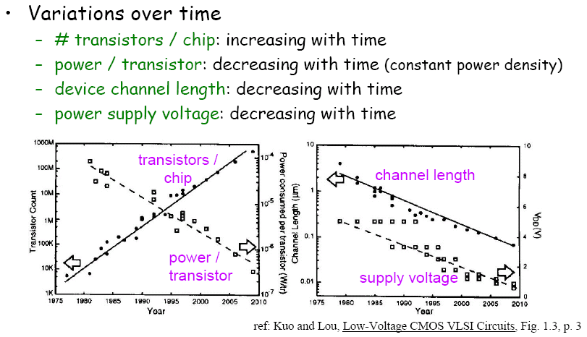
CMOS Technology Trend

Slide 20
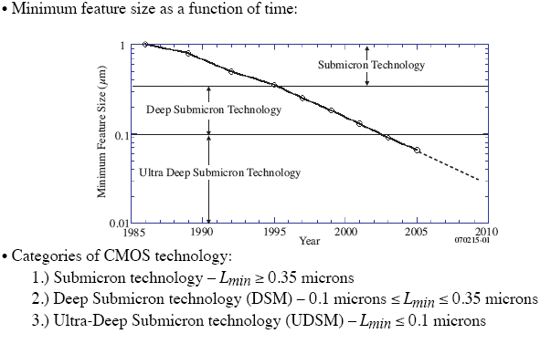
Categorization of CMOS Technology

Slide 21
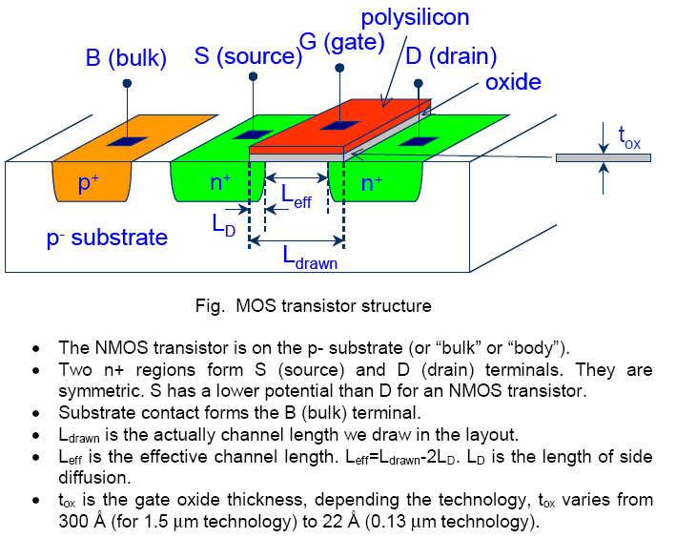
NMOS Transistor (nwell process)
,12Å for 65 nm technology

Slide 22
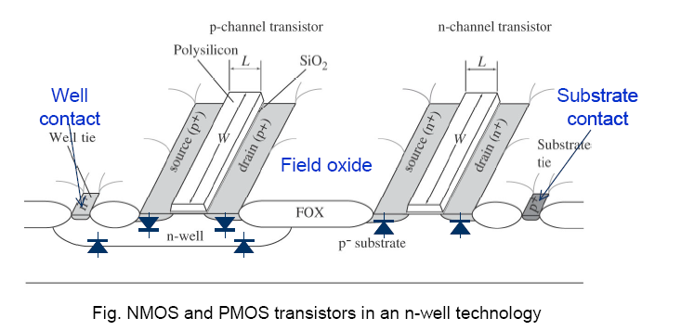
Notes:
FOX—Field Oxide

Slide 23

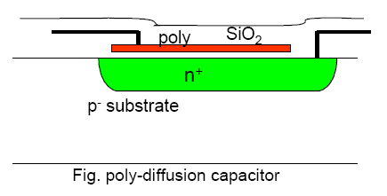
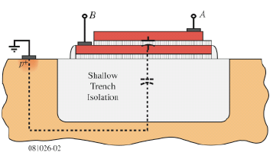
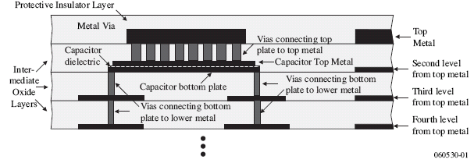
On Chip Passive components

Slide 24
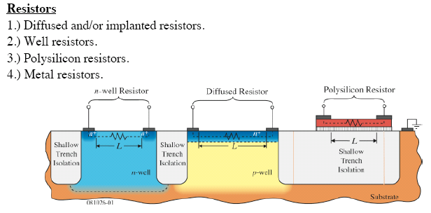

Slide 25
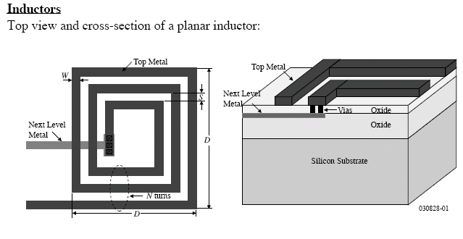

Slide 26
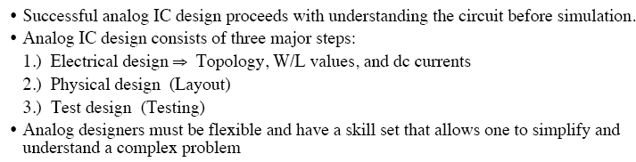
Summary

Slide 27
Resources
Glossary of EE terminology (from Analog Devices)

